Slide 1

A Look Back
This slide show is a great memento for your students and their families. It only takes a few minutes to put together, and the memories will be appreciated for a lifetime!

Slide 2
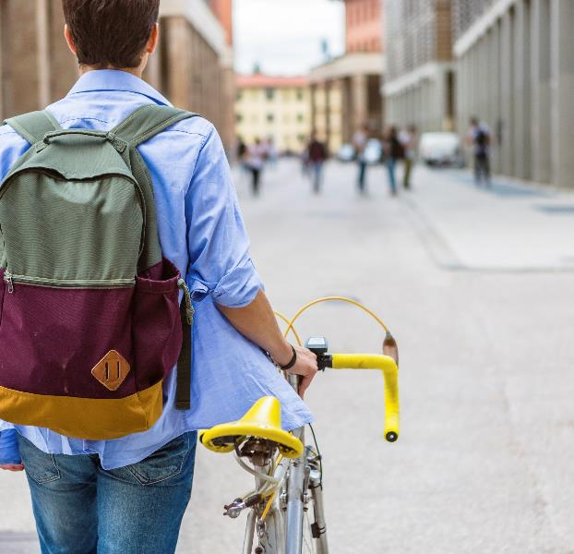
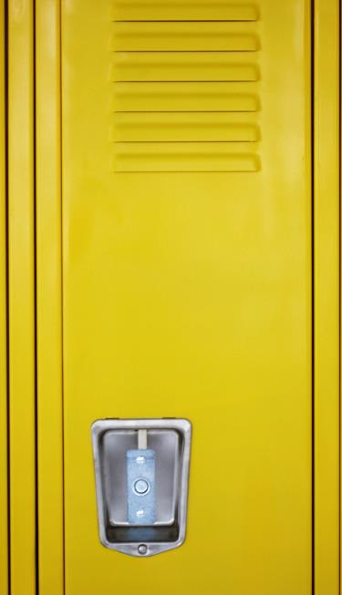

How We Started: The First Day
We lived, we laughed, we cried, we loved.
Notes:
Add photos of the first days of school – or the first weeks. Include a first day quote from students if you have them.

Slide 3

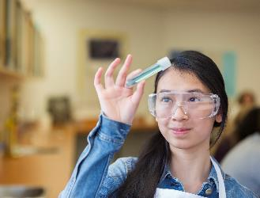
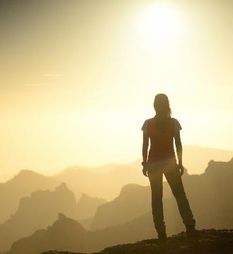


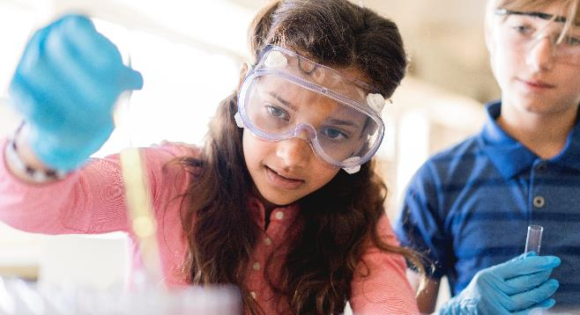
Autumn* Fun
Include pictures of the first term of school.
Think of pictures of students working together/reading books/doing art.
Notes:
*Change to Spring Fun for southern Hemisphere
Include pictures of the first term of school. Students working together/students reading books/working on projects or art, etc.

Slide 4
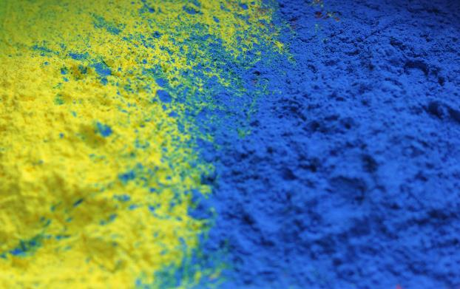



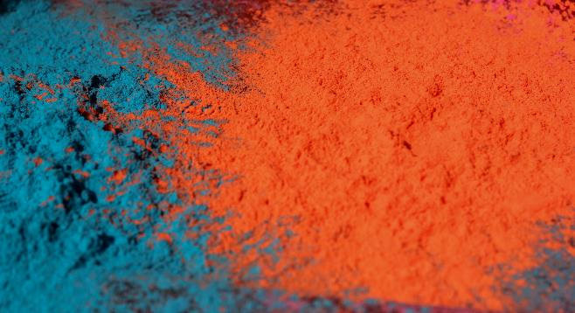
Winter* Times
Add pictures of student work here.
A collage of student work would be a great idea for this slide.
Notes:
*Change to Summer Times for Southern Hemisphere
Add pictures of student work here – projects they’ve completed; a collage of pictures would be a great idea

Slide 5
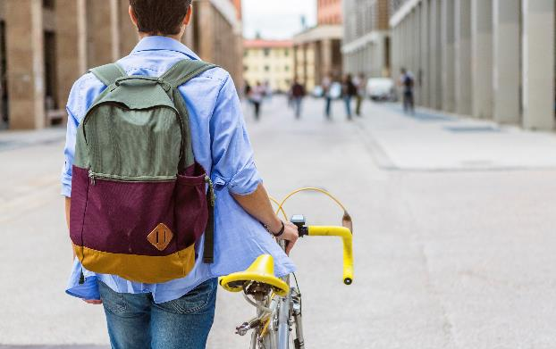



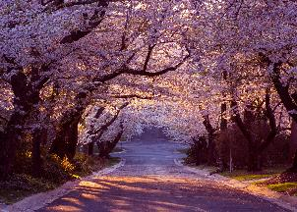

Spring* Excitement
Post a picture of being outdoors for an activity in this section.
Include any images of birthday celebrations you may have had.
Notes:
*Change to Autumn for southern hemisphere.

Slide 6


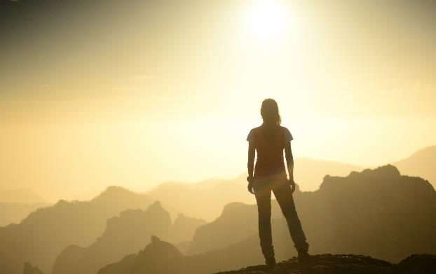
Field Trips*
Post a list of the field trips you experienced this year. Include digital field trips (via Skype, etc.).
If you took digital field trips, include quotes from your students on their experiences.
Include pictures from the excursions, or a short story of something remarkable that happened.
Notes:
*Out of School excursions

Slide 7
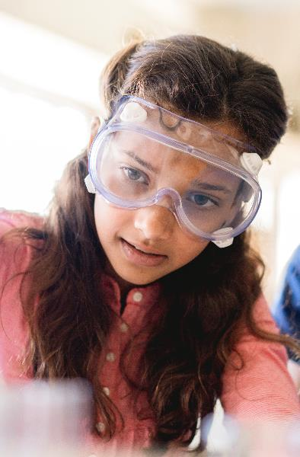





Special Guests
Include any career day visitors, volunteers, class celebration helpers, aids, guest speakers who worked with/visited your class this year.
Notes:
*Out of School excursions

Slide 8


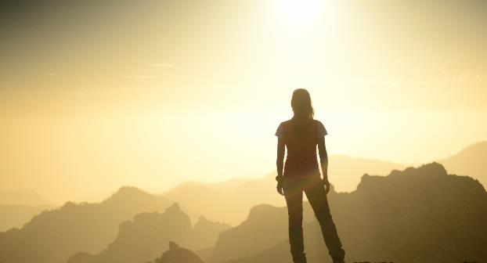
Honors
This is a great slide to use to highlight the honors your students have received. Student-of-the-month, reading or mathematics awards, or special community service they have done.
Include athletics and other club experiences where students have shown commitment.
Notes:
*Out of School excursions

Slide 9



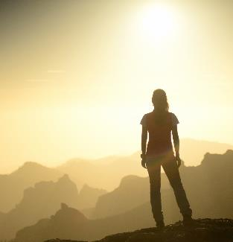
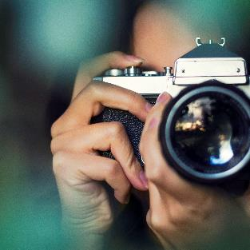
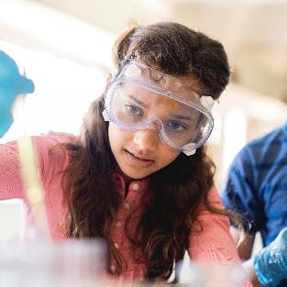





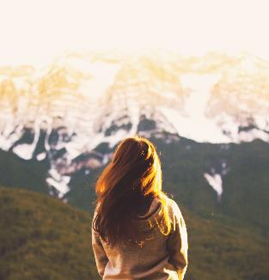
The Year Comes to a Close
Include a collage of pictures from the end of the year.
Use photos from assemblies, celebrations, commencements, etc.
Notes:
*Out of School excursions
Try to include some final quotes from students here.

Slide 10
Congratulations to Everyone!
Post a picture of yourself on this slide with a big congratulations smile for all the great students.
Notes:
*Out of School excursions

Slide 11
Customize this Template
Template Editing Instructions and Feedback

